Slide 1

Application Delivery Fundamentals
Nestjs
Parameswari Ettiappan

Slide 2
Goals
Foundations & First API
Services, Dependency Injection & Testing
Data, Validation & Configuration
GraphQL with NestJS
Advanced GraphQL in NestJS
Middleware, GuaAuthentication & Security
Authentication & Security
Documentation & File Handling
Micro-Frontend (MFE)

Slide 3
Goals
Nestia & Typia
Async Features & Microservices

Slide 4
Introduction
NestJS is a progressive Node.js framework for building efficient, scalable server-side apps.
It combines elements of Object-Oriented Programming (OOP), Functional Programming (FP) and Functional Reactive Programming (FRP) to deliver a unique development experience.
Uses modular architecture and dependency injection (DI)—very similar to Angular on the server.

Slide 5
FP vs FRP
Aspect | Functional Programming | Functional Reactive Programming
Focus | Data transformation | Data flow & time-dependent data
Core abstraction | Function | Observable (stream)
Data type | Static (arrays, lists) | Dynamic (events, async streams)
Execution | Pull (you call function) | Push (data arrives)
Example library | Lodash, Ramda | RxJS, Reactor, Combine, Akka
Used in | Pure JS, Kotlin, Python | NestJS, Angular, React, RxJS

Slide 6
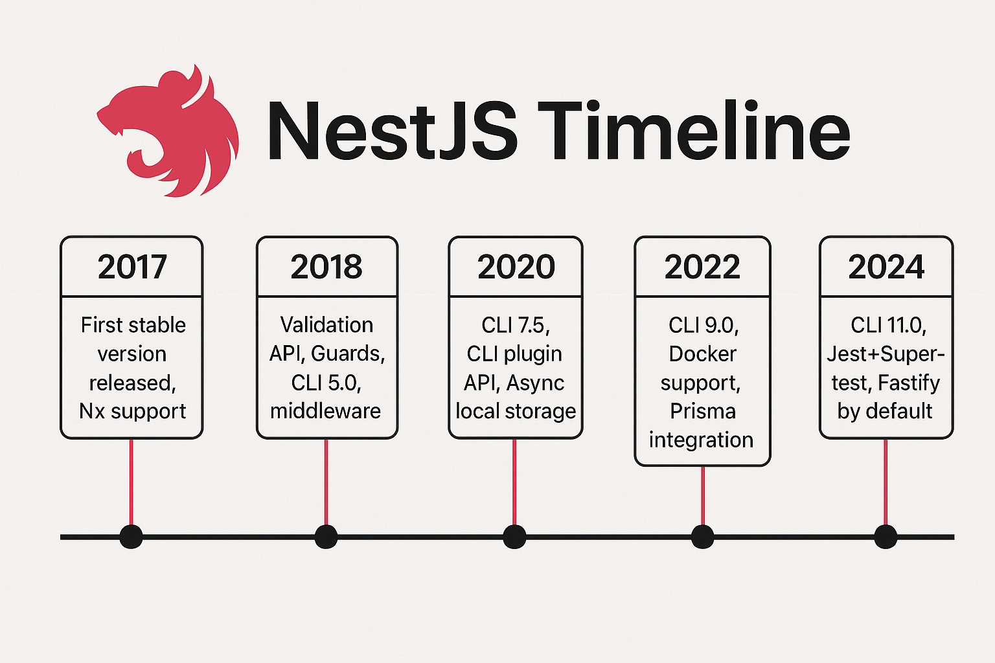
TimeLine

Slide 7
Why teams choose NestJS
Strong architecture (modules, DI, providers) → maintainable codebases
Batteries included: testing, validation, Swagger, config, guards, interceptors, microservices, GraphQL, WebSockets
Adapter-based: Express (default) or Fastify for better perf
Type-safe end-to-end with DTOs, pipes, and class-validator

Slide 8
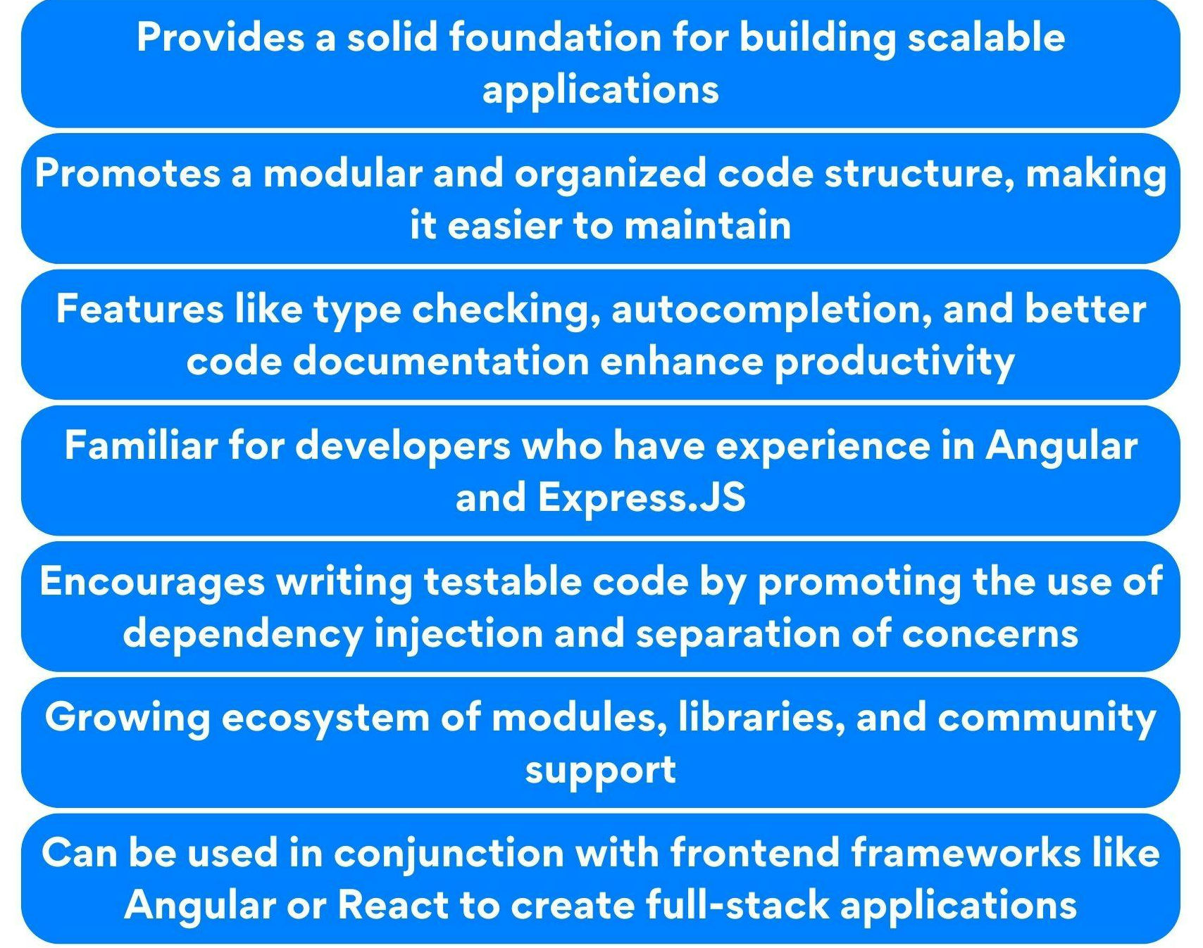
Why teams choose NestJS

Slide 9
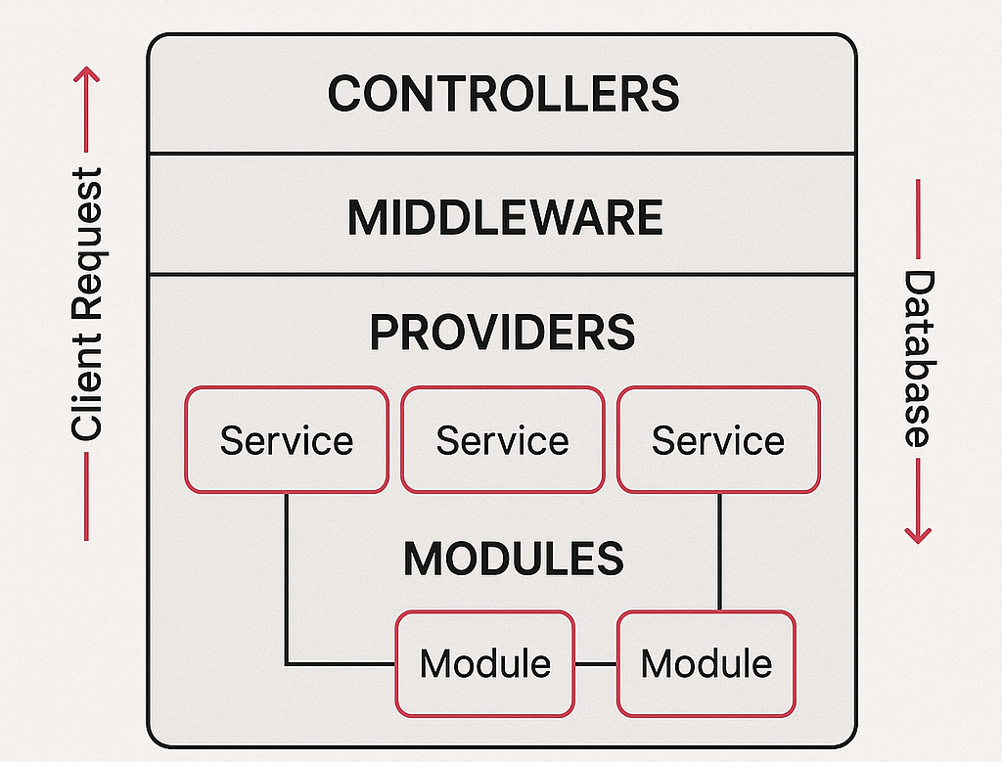
Nestjs Architecture

Slide 10
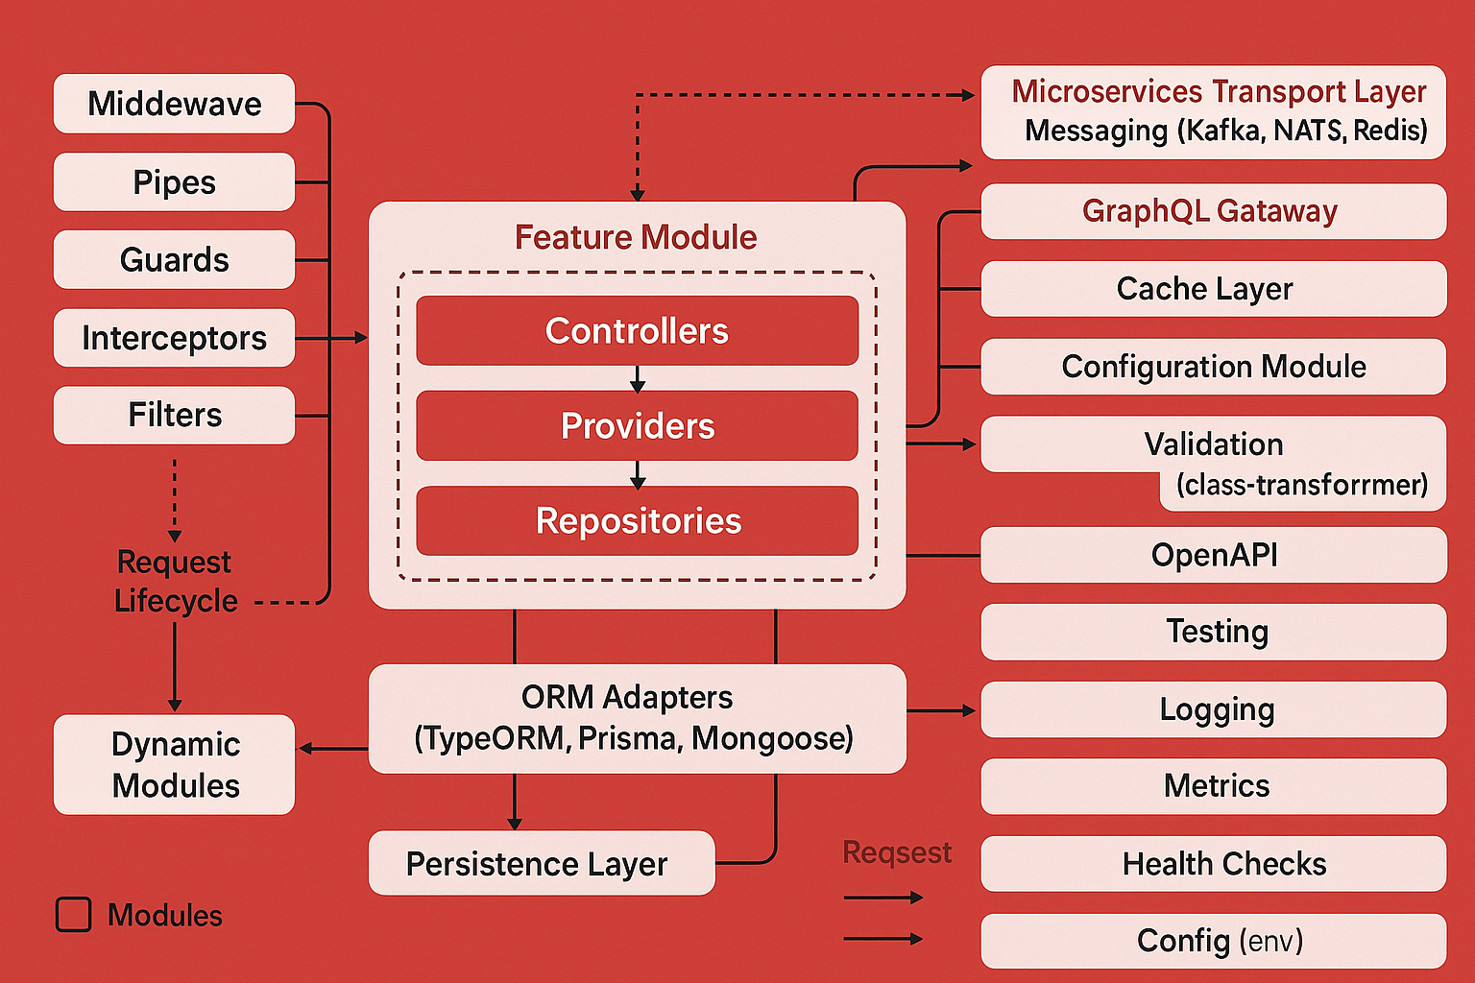
Nestjs Architecture in detail

Slide 11
🧱 1. Core Architecture Overview
NestJS follows a modular and layered architecture, where every feature is encapsulated inside a module. The core layers are:
Controllers – Handle incoming requests and return responses.
Providers (Services) – Contain business logic and can be injected into controllers or other providers.
Repositories – Handle data access (e.g., TypeORM, Prisma, or Mongoose models).
Modules – Organize the application into cohesive, reusable building blocks.

Slide 12
🔁 2. Request Lifecycle
Client Request → Enters the NestJS application.
Middleware → Runs before the route handler (e.g., logging, CORS, request parsing).
Guards → Check authorization or roles before proceeding.
Pipes → Validate and transform input data (e.g., DTO validation).
Interceptors → Modify or log the request/response, handle caching or timing.
Filters → Catch and format exceptions (e.g., HTTPExceptionFilter).
Controller → Receives a request, delegates logic to a Service.
Service → Performs business logic, calls repository or external APIs.
Repository / ORM Adapter → Interacts with the database.
Response → Travels back through interceptors and filters to the client.

Slide 13
⚙️ 3. Major Layers Explained
Middleware
Executes before route matching.
Common uses: logging, request tracking, CORS, JSON body parsing.
Pipes
Transform or validate request data.
Uses class-transformer and class-validator.
Guards
Decide if a request is allowed (e.g., JWT authentication, role-based access).
Return true or false.

Slide 14
⚙️ 3. Major Layers Explained
Interceptors
Wrap around controller logic to:
Transform output
Add extra behavior (logging, caching, timeout)
Modify responses before sending
Filters
Handle exceptions globally or per route.
Convert thrown errors into HTTP responses.

Slide 15
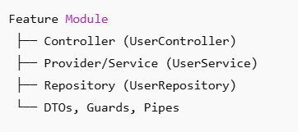
🧩 4. Feature Module Composition
Each module typically contains:
Controllers for API endpoints
Providers/Services for business logic
Repositories for database operations
Imports/Exports for sharing dependencies

Slide 16
🗄️ 5. Database Layer
The Persistence Layer is abstracted using ORMs or ODMs:
TypeORM, Prisma, Mongoose
Responsible for CRUD operations and mapping data models.
Injected via repositories into services.

Slide 17
☁️ 6. Integrations & Supporting Layers
Microservices Transport Layer: Communication via Kafka, NATS, or Redis.
GraphQL Gateway: Code-first or schema-first approach for GraphQL APIs.
Cache Layer: In-memory or Redis caching for performance.
Configuration Module: Handles .env configuration (via @nestjs/config).
Validation Module: Global validation pipes using class-transformer.

Slide 18
☁️ 6. Integrations & Supporting Layers
OpenAPI (Swagger): Auto-generates interactive API documentation.
Testing Module: Supports unit and e2e testing with @nestjs/testing.
Logging & Metrics: Interceptors or external tools (Winston, Pino, Prometheus).
Health Checks: Exposed endpoints for readiness/liveness probes.
Config (env): Centralized configuration for all modules.

Slide 19
🧠 7. Dynamic Modules
Dynamic modules allow:
Reusable modules with runtime configuration.
Conditional loading of providers or imports.
Example: ConfigModule.forRoot({ isGlobal: true })

Slide 20
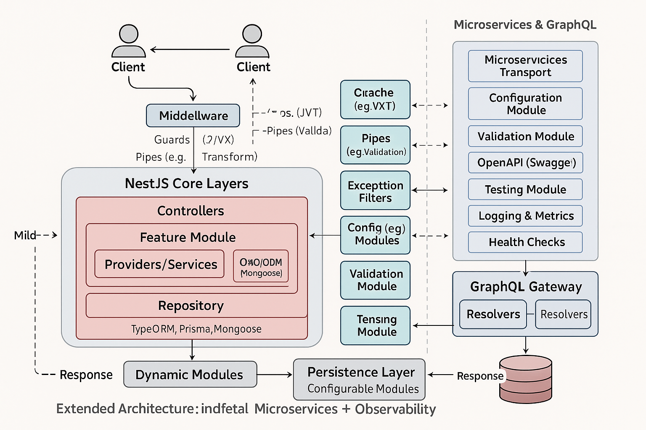
Nestjs Architecture

Slide 21
Common Tools and Integrations
Category | Tools
Messaging | Kafka, NATS, Redis Streams, RabbitMQ
Discovery | Consul, Eureka, API Gateway
Config Mgmt | Vault, ConfigModule, .env
Observability | Prometheus, Grafana, Loki, Jaeger
Security | JWT, Keycloak, OPA, RBAC Guards

Slide 22
Overview of Comparison
Framework | Language | Type | Primary Use | Core Philosophy
NestJS | TypeScript | Node.js | Enterprise-grade scalable apps | Modular, opinionated, Angular-like DI
Express.js | JavaScript | Node.js | Lightweight web apps | Minimalist, unopinionated
Fastify | TypeScript/JS | Node.js | High-performance REST APIs | Low overhead, schema-first
Django | Python | Full-stack | Web + ORM | “Batteries included”
Spring Boot | Java | Enterprise | Microservices, APIs | Convention-over-configuration
Laravel | PHP | Full-stack | Web + API | Elegant syntax, MVC

Slide 23
Architecture and Design
Aspect | NestJS | Express | Fastify | Django | Spring Boot | Laravel
Architecture | Modular, layered, DI | Flat, route-based | Plugin-based | MTV (Model-Template-View) | MVC with DI | MVC
Dependency Injection | ✅ Built-in | ❌ Manual | ❌ Manual | ✅ Via components | ✅ Powerful | ✅ Service container
Module System | ✅ Yes | ❌ No | ⚠️ Plugins only | ✅ Apps | ✅ Modules | ✅ Service providers
Middleware & Filters | ✅ Guards, Pipes, Filters | ✅ Middleware | ✅ Hooks | ✅ Middleware | ✅ Filters/Interceptors | ✅ Middleware
Scalability | High (modular & DI) | Medium (monolithic) | High | Medium | Very high | Medium-high
Testing support | Excellent (@nestjs/testing) | Manual setup | Manual | Built-in test runner | JUnit, MockMvc | PHPUnit

Slide 24
Performance
Metric | NestJS (Express) | NestJS (Fastify) | Pure Express | Fastify | Django | Spring Boot | Laravel
Requests/sec (approx) | ~28k | ~40k | ~30k | ~45k | ~15k | ~20k | ~18k
Cold start (ms) | ~120 | ~100 | ~80 | ~90 | ~150 | ~250 | ~200
Concurrency Handling | Excellent | Excellent | Good | Excellent | Moderate | Excellent | Moderate

Slide 25
Developer Experience
Feature | NestJS | Express | Fastify | Django | Spring Boot | Laravel
CLI Generator | ✅ nest-cli | ⚠️ 3rd-party | ⚠️ 3rd-party | ✅ django-admin | ✅ spring-cli | ✅ artisan
Type Safety | ✅ Full TS | ⚠️ via TS wrappers | ✅ Native | ❌ Dynamic | ✅ Strong | ⚠️ Optional
Built-in Validation | ✅ class-validator | ❌ | ✅ via AJV | ✅ forms & serializers | ✅ Hibernate validator | ✅ Validator
API Docs (Swagger) | ✅ Built-in module | ❌ | ⚠️ Plugin | ✅ DRF Swagger | ✅ SpringDoc | ⚠️ Package
ORM Integration | ✅ TypeORM, Prisma, Mongoose | ⚠️ Mongoose | ⚠️ Prisma | ✅ ORM built-in | ✅ JPA/Hibernate | ✅ Eloquent

Slide 26
Developer Experience
Microservices Support | ✅ Native | ❌ | ⚠️ Plugins | ⚠️ Celery | ✅ Native | ⚠️ Limited
GraphQL Support | ✅ @nestjs/graphql | ⚠️ apollo-server | ⚠️ plugin | ✅ graphene | ✅ Spring GraphQL | ✅ Lighthouse
WebSockets | ✅ @nestjs/websockets | ✅ socket.io | ✅ plugin | ⚠️ Channels | ✅ STOMP/WebSocket | ⚠️ Package
Security Tools | ✅ Helmet, Guards | ⚠️ Manual | ✅ Plugin | ✅ CSRF, Auth | ✅ Spring Security | ✅ Built-in Auth

Slide 27
Use Cases
Framework | Ideal For
NestJS | Large-scale enterprise backends, microservices, GraphQL APIs, modular apps needing DI and testing
Express.js | Small to mid-size REST APIs, prototypes, learning Node.js
Fastify | High-performance APIs, IoT backends, edge computing
Django | Monolithic web apps, dashboards, CMS, data-heavy apps
Spring Boot | Enterprise Java microservices, fintech, insurance, banking
Laravel | Rapid PHP app development, web portals, eCommerce

Slide 28
Security and Stability
Security Layer | NestJS | Django | Spring Boot | Laravel
Input Validation | ✅ Pipes, DTOs | ✅ Forms | ✅ Bean Validation | ✅ Requests
Auth | ✅ Passport (JWT, OAuth2) | ✅ Auth system | ✅ Spring Security | ✅ Guards, Sanctum
CSRF/XSS | ✅ Helmet + Guards | ✅ Built-in | ✅ Filters | ✅ Built-in
HTTPS/SSL | ✅ Reverse proxy setup | ✅ Built-in | ✅ Configurable | ✅ Configurable
Error Handling | ✅ Filters + Interceptors | ✅ Middleware | ✅ ExceptionHandlers | ✅ Handlers

Slide 29
. Scalability & Microservices
Framework | Scalability | Microservices | Cloud-Native Ready
NestJS | ✅ Modular DI | ✅ TCP, Kafka, Redis, NATS | ✅ Yes (Docker, Kubernetes, Serverless)
Express.js | ⚠️ Monolithic | ⚠️ Manual setup | ✅ Yes
Fastify | ✅ Stateless & lightweight | ⚠️ Manual setup | ✅ Yes
Django | ⚠️ Moderate | ⚠️ Celery tasks | ✅ With Docker
Spring Boot | ✅ Excellent | ✅ Spring Cloud | ✅ Native
Laravel | ⚠️ Limited | ⚠️ Event-driven | ✅ Yes (Forge, Vapor)

Slide 30
Pros & Cons Summary
Framework | Pros | Cons
NestJS | Enterprise architecture, DI, strong typing, Swagger, testing | Slight learning curve
Express | Simple, huge ecosystem, fast prototyping | No structure, hard to scale
Fastify | Extremely fast, low overhead | Less middleware ecosystem
Django | Complete stack, admin UI, ORM | Heavy for small APIs
Spring Boot | Robust, mature, enterprise-grade | Verbose, slower cold starts
Laravel | Elegant, full-stack, easy for web devs | Slower runtime, PHP-bound

Slide 31
Verdict
Scenario | Best Choice
🚀 Modern scalable REST API (Node ecosystem) | NestJS (Fastify adapter)
🧪 Quick prototype / simple API | Express.js
⚡ High-performance microservice | Fastify or NestJS-Fastify
🧠 Enterprise, strict typing, layered design | NestJS or Spring Boot
🧰 All-in-one full-stack web app | Django or Laravel
☁️ Cloud-native microservices (Java) | Spring Boot

Slide 32
Installing Nest CLI
🧩 1. Nest CLI (Command Line Interface)
🔹 What It Is
The Nest CLI (@nestjs/cli) is an official tool to:
Scaffold projects quickly
Generate modules, controllers, and services
Handle build/test/lint workflows
Manage configuration and packaging
It ensures project structure consistency and best practices.

Slide 33
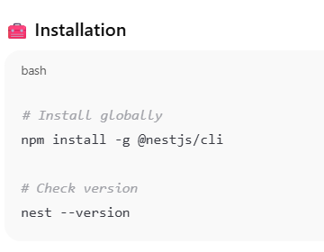
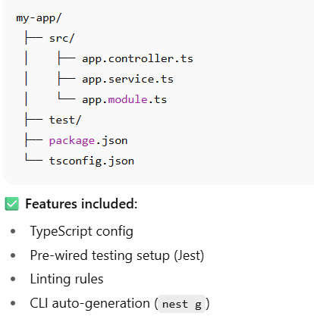
Installing Nest CLI

Slide 34
🧭 What Is a Monorepo?
A Monorepo (“monolithic repository”) is a single Git repository that contains multiple related projects — such as backend services, frontend apps, shared libraries, and utilities — all managed together.
Instead of separate repos for each service (polyrepo), a monorepo brings them into one cohesive workspace.

Slide 35
Monorepo vs Polyrepo
Feature | Monorepo | Polyrepo
Definition | All apps, services, and libs live in one Git repository | Each app/service in its own repo
Example Structure | apps/ and libs/ inside one repo | auth-service.git, user-service.git, etc.
Dependency Mgmt | Centralized (package.json or workspace tools like Nx/Turbo) | Each repo manages its own dependencies
Code Sharing | Simple — import shared libraries | Hard — publish shared packages separately
Refactoring | Easier (one commit affects all) | Tedious (sync across repos)
CI/CD Pipelines | Unified | Multiple separate pipelines
Access Control | Coarse (repo-level) | Fine-grained per repo
Scaling Team | Excellent for cross-team collaboration | Slower for multi-team environments

Slide 36
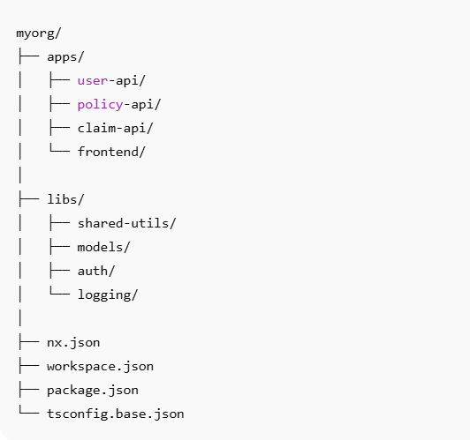
⚙️ Monorepo Folder Structure (Typical Nx Example)

Slide 37
🧠 Tools for Monorepos
Tool | Description | Language Ecosystem
Nx | Full-featured monorepo tool for JS/TS (NestJS, Angular, React) | JS/TS
Turborepo | Lightweight task runner for monorepos | JS/TS
Lerna | Package management for multi-package repos | JS
Bazel | Google’s build system for huge repos (TensorFlow, Google) | Polyglot
Rush.js | Enterprise-grade monorepo manager | JS

Slide 38
Nx CLI (by Nrwl)
Nx is a powerful build system and monorepo manager that works seamlessly with NestJS.
It allows you to organize multiple apps and libraries (frontend + backend + shared code) in one workspace.
Think of Nx as:
“A smart workspace tool for managing large-scale, multi-project ecosystems.”

Slide 39
Installation
# Install Nx globally
npm install -g nx
From node js cmd
corepack enable
corepack prepare pnpm@9 --activate
pnpm -v
1) Create Nx Workspace (Nest preset)
npx --yes create-nx-workspace@latest boeing-insurance --preset=nest --appName=api-gateway --workspaceType=integrated --packageManager=npm --e2eTestRunner=none --unitTestRunner=jest --nxCloud=skip --skipGit --interactive=false
# Choose: preset → nest, npm (or pnpm/yarn)
cd boeing-insurance

Slide 40
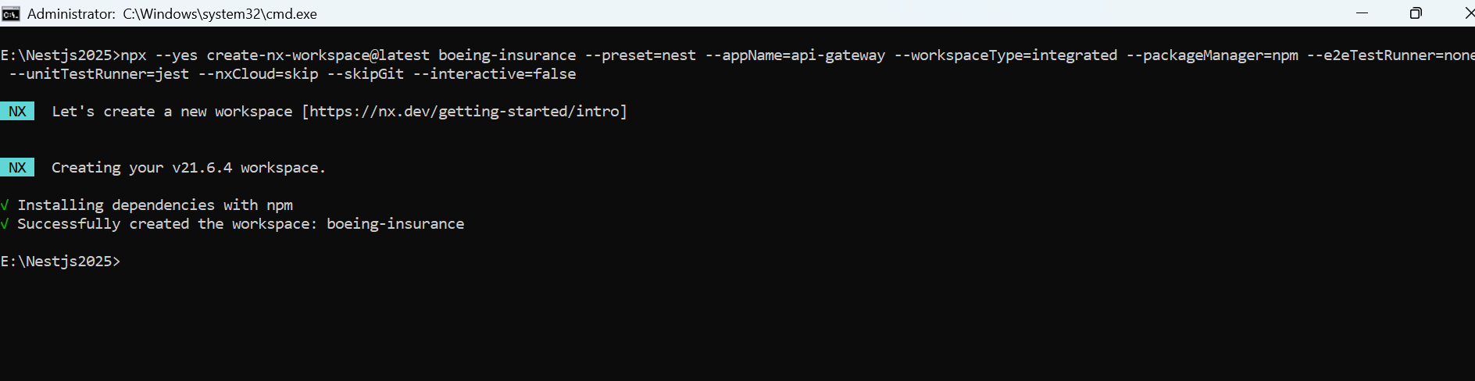
Installation

Slide 41
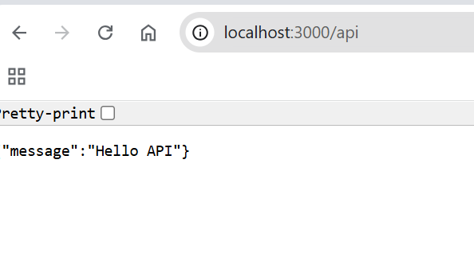
Installation
npx nx show projects
npx nx serve api-gateway
#LOG 🚀 Application is running on: http://localhost:3000/api

Slide 42
Customer API
1) Generate the app
# from the workspace root (boeing-insurance)
npx nx g @nx/nest:app customer-api --e2eTestRunner=none
2) Show Project
npx nx show project customer-api

Slide 43
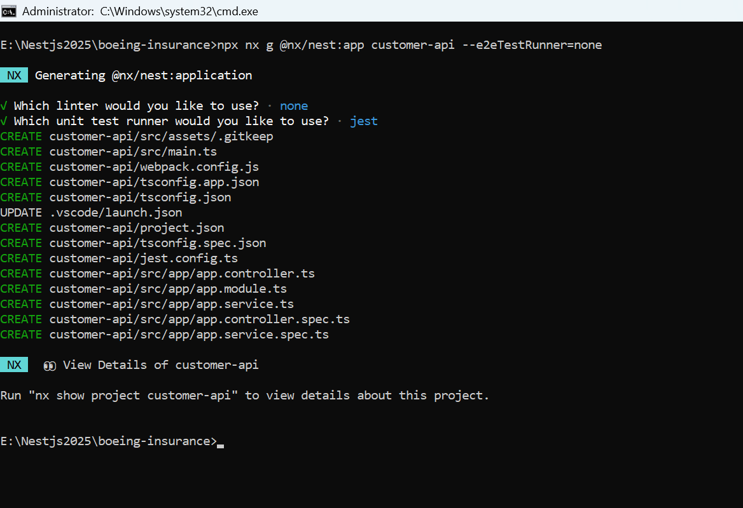
Customer API

Slide 44
Customer API
2) Scaffold the “customers” feature
cd customer-api
npx -p @nestjs/cli nest g module app/customers
npx -p @nestjs/cli nest g service app/customers --flat
npx -p @nestjs/cli nest g controller app/customers --flat

Slide 45
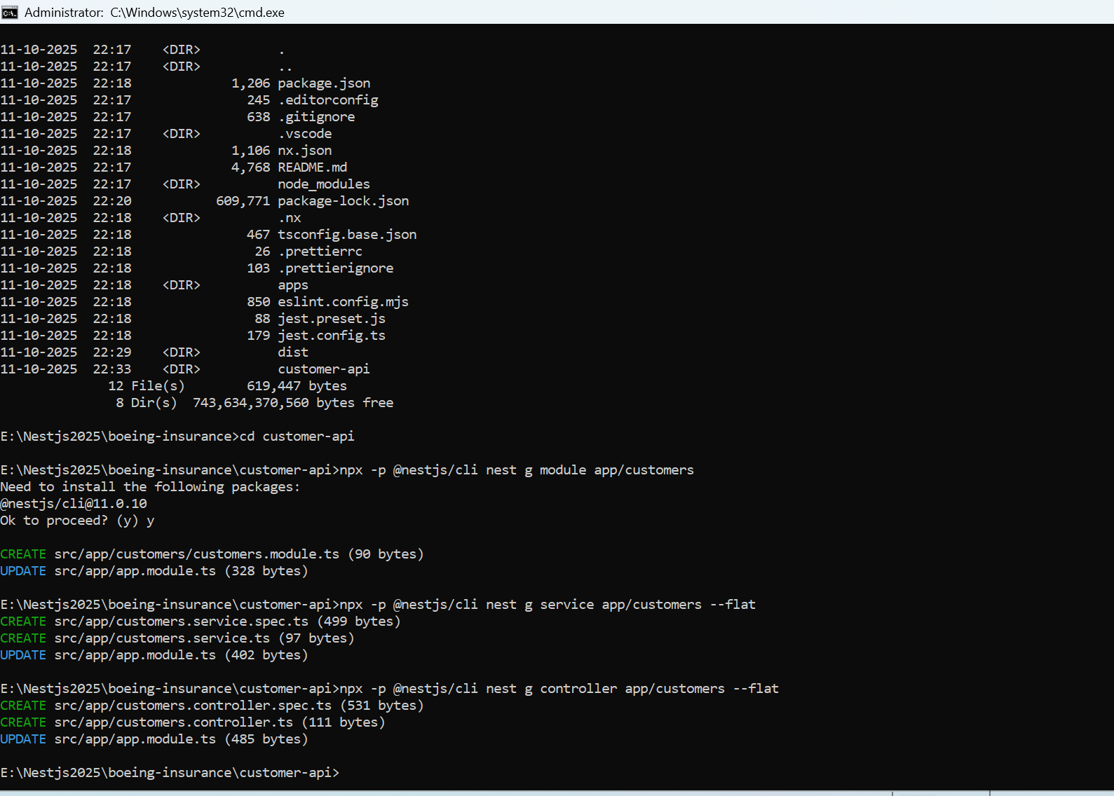

Customer API

Slide 46
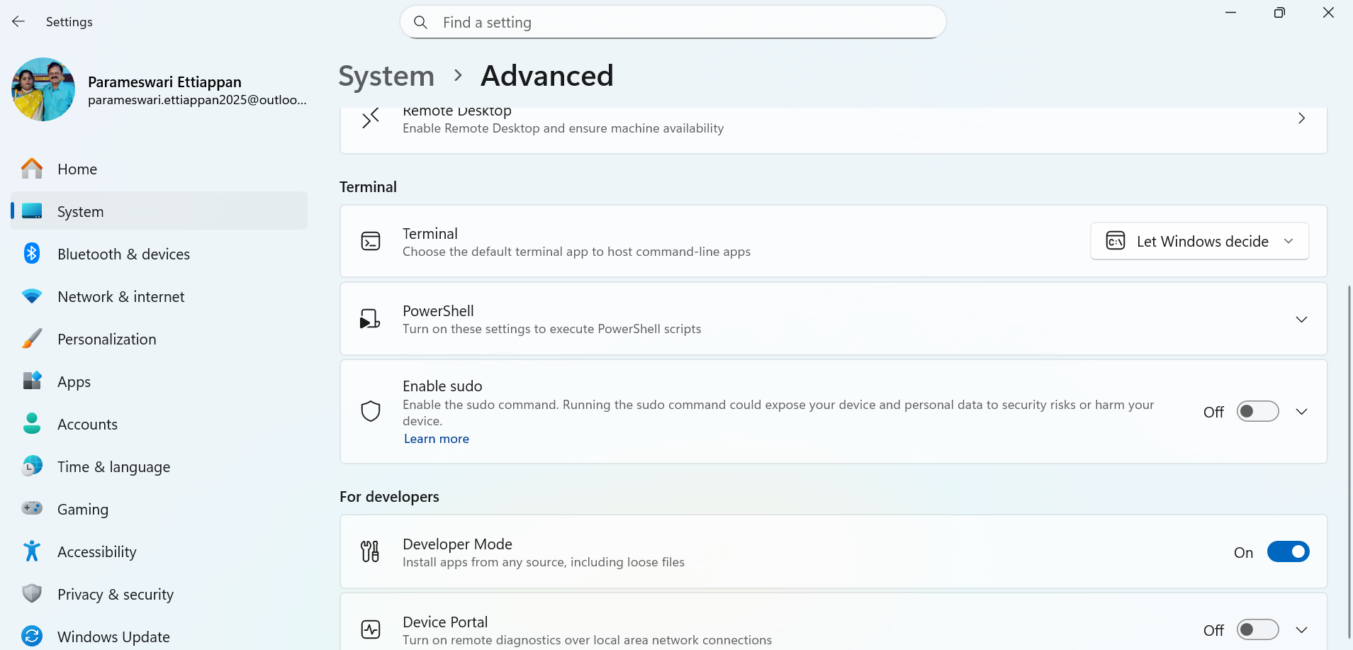

Installation

Slide 47
Why Nx Is Great for NestJS
Feature | Benefit
Monorepo management | Manage multiple microservices or APIs in one workspace
Code sharing | Share DTOs, interfaces, utils between apps/libraries
Dependency graph | Nx visualizes how modules depend on each other
Incremental builds | Rebuild only affected projects (saves CI/CD time)
Generators | Create apps, libs, modules, and components instantly
Consistency | Enforces structure across all projects
Caching | Remote caching across CI pipelines for faster builds
Integration | Works with NestJS, Angular, React, Next.js, and more

Slide 48
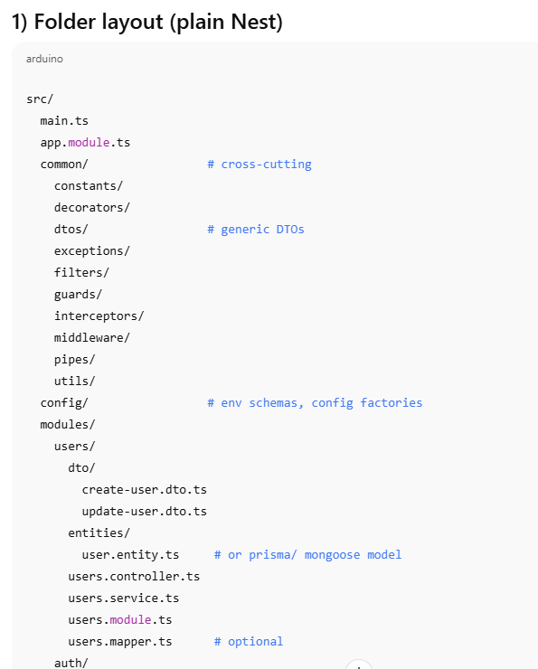
Folder Layout (Nest)

Slide 49
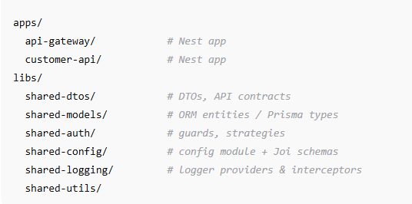
Folder layout (Nx monorepo)

Slide 50
Naming conventions
Files: kebab-case.ts; Classes: PascalCase; vars: camelCase.
Suffixes: *.module.ts, *.controller.ts, *.service.ts, *.guard.ts, *.pipe.ts, *.filter.ts, *.interceptor.ts, *.repository.ts, *.dto.ts.
DTOs: CreateXDto, UpdateXDto, XQueryDto (for filters/pagination).
Providers tokens: SYMBOL_CASE or Symbol('MyToken') for non-class injections.

Slide 51
Module boundaries
One feature module per domain (e.g., UsersModule).
Keep controllers thin: no business logic in controllers.
Services call repositories/ORM; repositories wrap the data layer.
Export only what another module needs (exports: [UsersService]).
Avoid circular deps; use forwardRef only as a last resort.

Slide 52
Controller conventions
Base path plural: @Controller('users').
Versioning: enable URI (/v1/...) or header (VERSIONING_TYPE).
HTTP codes:
POST → 201, set @HttpCode(201) (Nest sets automatically on @Post() if you return created)
GET collection → 200, item not found → 404
PUT/PATCH → 200/204, DELETE → 204
Pagination: ?page=1&limit=20&sort=createdAt:desc.
Return shape: { data, meta: { total, page, limit } }.

Slide 53
DTO + validation
Global pipe in main.ts:
app.useGlobalPipes(new ValidationPipe({
whitelist: true, forbidNonWhitelisted: true, transform: true
}));
Use class-validator & class-transformer only in dto/:
export class CreateUserDto {
@IsString() @MinLength(2) name!: string;
@IsEmail() email!: string;
}

Slide 54
Error & response shape
Throw typed errors in services; map to HTTP in filters if needed.
@Catch(DomainError)
export class DomainErrorFilter implements ExceptionFilter { ... }
Standard error payload:
{ "error": "ValidationError", "message": "...", "details": [{ "field": "email", "msg": "invalid" }] }

Slide 55
Config & environments
config/
app.config.ts # returns { port, env }
db.config.ts # returns { url }
validation.ts # Joi schema
Boot:
ConfigModule.forRoot({ isGlobal: true, validationSchema: EnvSchema });
.env files: .env, .env.local, .env.test (never commit real secrets).

Slide 56
Data layer conventions
Prisma: prisma/schema.prisma; repositories wrap PrismaClient.
TypeORM: entities/, migrations/, repositories/.
Repositories expose domain-friendly methods (no ORM types leaking out).

Slide 57
Cross-cutting concerns
Guards: authz (JWT, roles) in common/guards.
Interceptors: logging, caching, class-serializer.
Filters: map domain/runtime errors to HTTP.
Pipes: param parsing (ParseUUIDPipe), validation.
Middleware: tracing IDs, raw access logs (pre-routing).

Slide 58
Logging & tracing
Use a request-scoped correlation ID (middleware).
Central logger (Winston/Pino) provider in shared-logging.
Optional: expose /health with @nestjs/terminus.

Slide 59
API docs (Swagger)
const cfg = new DocumentBuilder().setTitle('Customer API').setVersion('v1').addBearerAuth().build();
const doc = SwaggerModule.createDocument(app, cfg);
SwaggerModule.setup('docs', app, doc);
Decorate DTOs with @ApiProperty when needed.
Hide internals with @ApiHideProperty.

Slide 60
Testing layout
src/
modules/users/...
test/ or __tests__/
users.controller.spec.ts
users.service.spec.ts
Unit: mock external deps (DB, HTTP).
E2E: supertest with app.init() (no listen()).
Nx: nx test <project>, nx affected:test, coverage per project.

Slide 61
Git, lint & formatting
ESLint + Prettier; strict TS ("strict": true).
Commit messages: Conventional Commits (feat:, fix:, chore:).
Enforce import paths with tsconfig paths (@app/..., @shared/...).

Slide 62
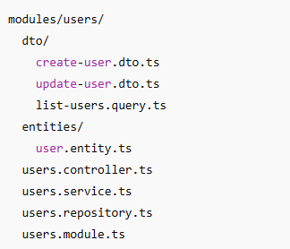
Typical feature files (example)

Slide 63
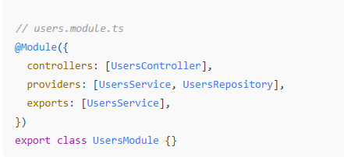
Example of Minimal Module

Slide 64
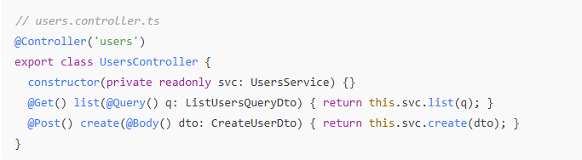
Example of Minimal Module

Slide 65
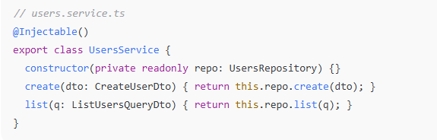
Example of Minimal Module

Slide 66
Versioning & deprecation
Turn on versioning in main.ts and route under /v1.
Use @ApiDeprecated() on endpoints being phased out.

Slide 67
Nx-specific tips
Generate libraries for shared concerns:
nx g @nx/js:lib shared-dtos
nx g @nx/js:lib shared-auth
Visualize deps: nx graph.
Affected commands in CI: nx affected:build, nx affected:test.

Slide 68
Swagger Library
Install from ws
npm i @nestjs/swagger swagger-ui-express class-validator class-transformer

Slide 69
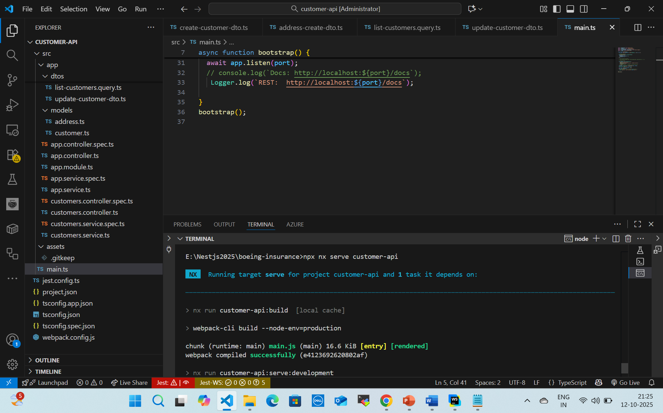
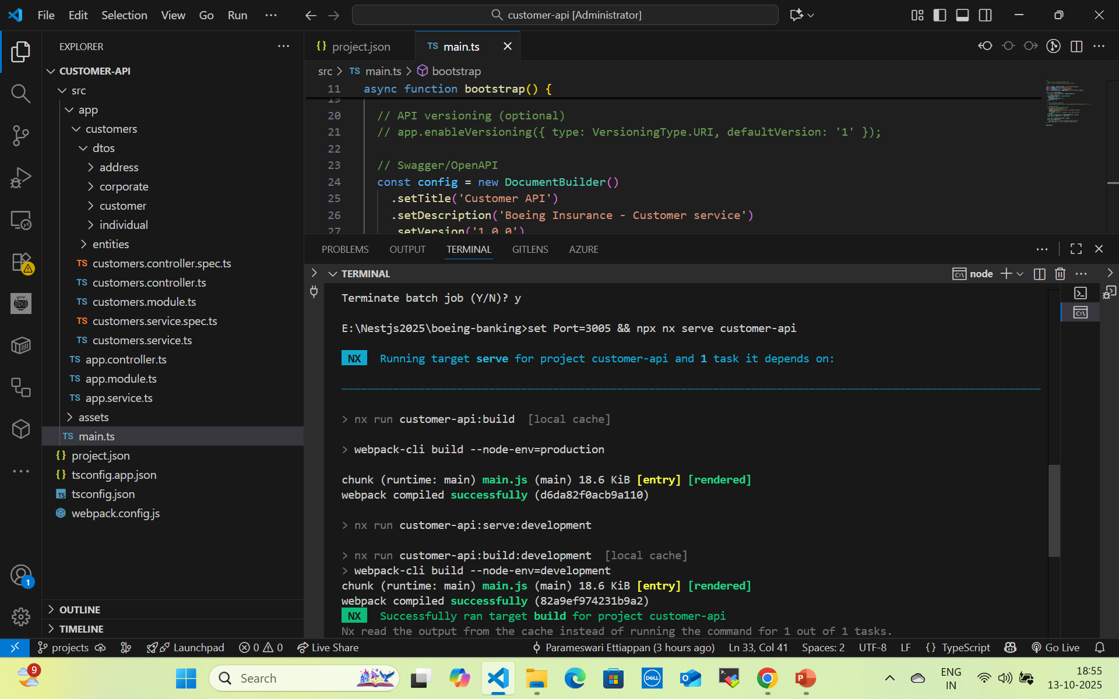
Run Swagger app
set Port=3005 && npx nx serve customer-api

Slide 70
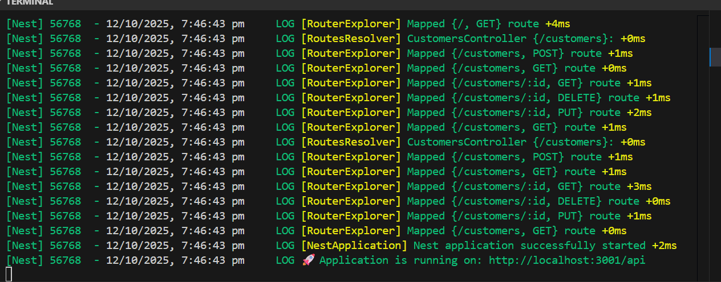
Run Swagger app

Slide 71
ORM Postgres
Install
npm i @nestjs/typeorm typeorm pg class-validator class-transformer

Slide 72
Quick Intro to Typia (typia.validate()) for runtime type safety

Slide 73
Mongodb Packages
npm i @nestjs/mongoose mongoose
npm i class-validator class-transformer
npm i dotenv

Slide 74
Jest Unit Testing
Jest is a JavaScript testing framework commonly used for testing Node.js, TypeScript, and React applications.
It’s fast, simple to set up, and works well with frameworks like NestJS, Express, or React.

Slide 75
1. Install Jest
For a Node.js / TypeScript project:
npm install --save-dev jest ts-jest @types/jest
From Project Folder
npm i --save-dev @types/jest
Initialize Jest config:
npx create-jest
When prompted:
This will start an interactive setup similar to the old --init, asking questions like:
✔ Would you like to use Typescript for the configuration file? … yes
✔ Choose the test environment that will be used for testing › node
✔ Do you want Jest to add coverage reports? … yes
✔ Automatically clear mock calls, instances, contexts and results before every test? … yes

Slide 76
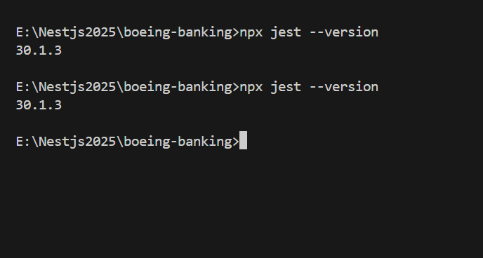
Test Jest Installation

Slide 77
Configure Jest (TypeScript Example)
In jest.config.ts:
Import type { Config } from 'jest';
const config: Config = {
preset: 'ts-jest',
testEnvironment: 'node',
moduleFileExtensions: ['ts', 'js', 'json'],
// rootDir: 'src',
testRegex: '.*\\.spec\\.ts$', // files ending in .spec.ts
collectCoverage: true,
coverageDirectory: '../coverage',
};
export default config;

Slide 78
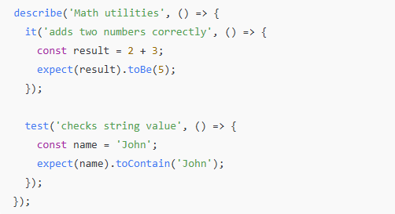
Jest Syntax
Function | Purpose
describe() | Groups related tests
it() or test() | Defines a single test case
expect() | Asserts the expected result

Slide 79
Common Jest Matchers
Matcher | Example | Description
.toBe() | expect(a).toBe(5) | Exact value (===)
.toEqual() | expect(obj).toEqual({a:1}) | Deep equality
.toBeTruthy() / .toBeFalsy() |  | Boolean checks
.toContain() | expect(array).toContain(3) | Array or string includes
.toHaveLength() | expect(arr).toHaveLength(3) | Length check
.toThrow() | expect(fn).toThrow() | Error handling
.toBeCalledWith() | expect(mockFn).toBeCalledWith(arg) | Mock call check

Slide 80
. Common Jest Matchers
Matcher | Purpose
toBe(value) | Compare primitive values
toEqual(obj) | Deep object comparison
toBeNull() | Check null
toBeDefined() | Check defined
toContain(item) | Array or string includes
toThrow() | Function throws error

Slide 81
NestJS Example – Controller Test
✅ Step 1: Import TestingModule
import { Test, TestingModule } from '@nestjs/testing';
import { CustomersController } from './customers.controller';
import { CustomersService } from './customers.service';

Slide 82
NestJS Example – Controller Test
✅ Step 2: Create Mocks for the Service
const mockCustomersService = {
createCustomer: jest.fn(),
getAllCustomers: jest.fn(),
getCustomerByAccountNo: jest.fn(),
updateCustomer: jest.fn(),
deleteCustomer: jest.fn(),
};

Slide 83
NestJS Example – Controller Test
✅ Step 3: Build a TestingModule
let controller: CustomersController;
let service: CustomersService;
beforeEach(async () => {
const module: TestingModule = await Test.createTestingModule({
controllers: [CustomersController],
providers: [
{ provide: CustomersService, useValue: mockCustomersService },
],
}).compile();
controller = module.get<CustomersController>(CustomersController);
service = module.get<CustomersService>(CustomersService);
});

Slide 84
NestJS Example – Controller Test
✅ Step 4: Write a Test Case
it('should create a customer', () => {
const dto = { firstName: 'John', lastName: 'Doe' };
mockCustomersService.createCustomer.mockReturnValue(dto);
const result = controller.createCustomer(dto as any);
expect(result).toEqual(dto);
expect(service.createCustomer).toHaveBeenCalledWith(dto);
});

Slide 85
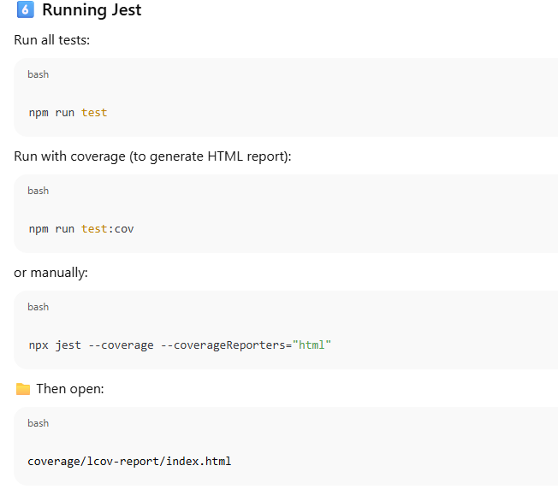
NestJS Example – Controller Test

Slide 86
Coverage Report
Run:
npx jest --coverage
This generates an HTML report in /coverage.

Slide 87
Mock Swagger
1) Add a mock module for Swagger
test/mocks/nestjs-swagger.mock.ts
// Make every decorator a no-op so class definition succeeds in tests.
export const ApiProperty = () => () => {};
export const ApiPropertyOptional = () => () => {};
export const ApiTags = () => () => {};
export const ApiResponse = () => () => {};
export const ApiBearerAuth = () => () => {};
export const ApiOperation = () => () => {};
export const ApiParam = () => () => {};
export const ApiQuery = () => () => {};
export const ApiBody = () => () => {};

Slide 88
Mock Swagger
2) Map @nestjs/swagger to the mock in Jest
jest.config.ts
import type { Config } from 'jest';
const config: Config = {
preset: 'ts-jest',
testEnvironment: 'node',
moduleNameMapper: {
'^@nestjs/swagger$': '<rootDir>/test/mocks/nestjs-swagger.mock.ts',
},

Slide 89
Mock Swagger
// (optional but often helpful)
globals: {
'ts-jest': {
tsconfig: {
experimentalDecorators: true,
emitDecoratorMetadata: true,
esModuleInterop: true,
useDefineForClassFields: false,
},
},
},
};
export default config;

Slide 90
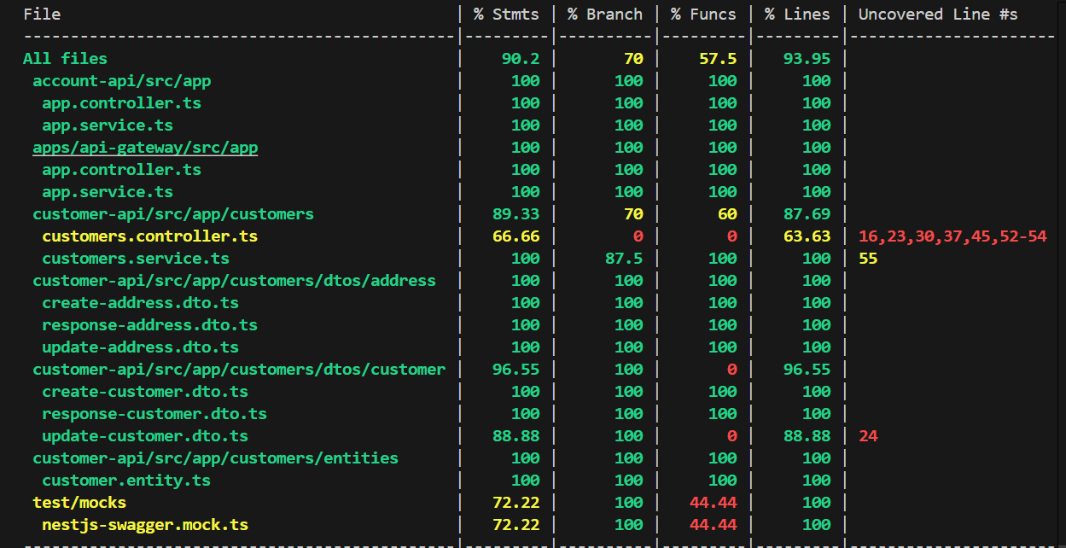
Npx jest

Slide 91
Build Multiple Projects - Docker
From the repo root:
# Account API image
docker build \
--build-arg APP_NAME=account-api \
--build-arg DIST_DIR=dist/account-api \
--build-arg PORT=3001\
-t account-api:latest .
# Transactions API image
docker build \
--build-arg APP_NAME=transaction-api \
--build-arg DIST_DIR=dist/transaction-api \
--build-arg PORT=3000 \
-t transaction-api:latest .

Slide 92
Docker Postgres
docker exec -it f189c182c055 psql -U postgres

Slide 93
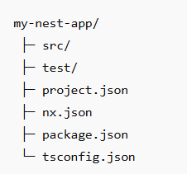
Standalone Nest Project
npx create-nx-nest@latest my-nest-app
(Or) nest new my-nest-app
npx nx serve
npx nx build
npx nx test

Slide 94
Graphql
npm i @nestjs/graphql @nestjs/apollo graphql graphql-tag class-validator class-transformer
#if you are in root folder
npx nx g @nx/nest:module books --project=account-api
npx nx g @nx/nest:resolver books --project=account-api --no-spec
npx nx g @nx/nest:service books --project=account-api --no-spec

Slide 95
Graphql
#if you are in project folder
npx nx g @nx/nest:module books
npx nx g @nx/nest:resolver books --no-spec
npx nx g @nx/nest:service books --no-spec
npm run start:dev
Open http://localhost:3000/graphql

Slide 96
Query
mutation {
createBook(input: { title: "The Pragmatic Programmer", author: "Andrew Hunt", pages: 352 }) {
id title author pages
}
}
query($id: ID!) {
book(id: $id) { id title author pages }
}

Slide 97
Query
mutation($input: UpdateBookInput!) {
updateBook(input: $input) { id title author pages }
}
{
"input": { "id": "4fce137d-3755-4c3c-9e3d-e559d6c3987c", "pages": 400 }
}
mutation($id: ID!) {
removeBook(id: $id)
}

Slide 98
Query
query{
accounts{
accountNo
}
}
query{
accounts{
accountNo,
runningTotal
}
}

Slide 99
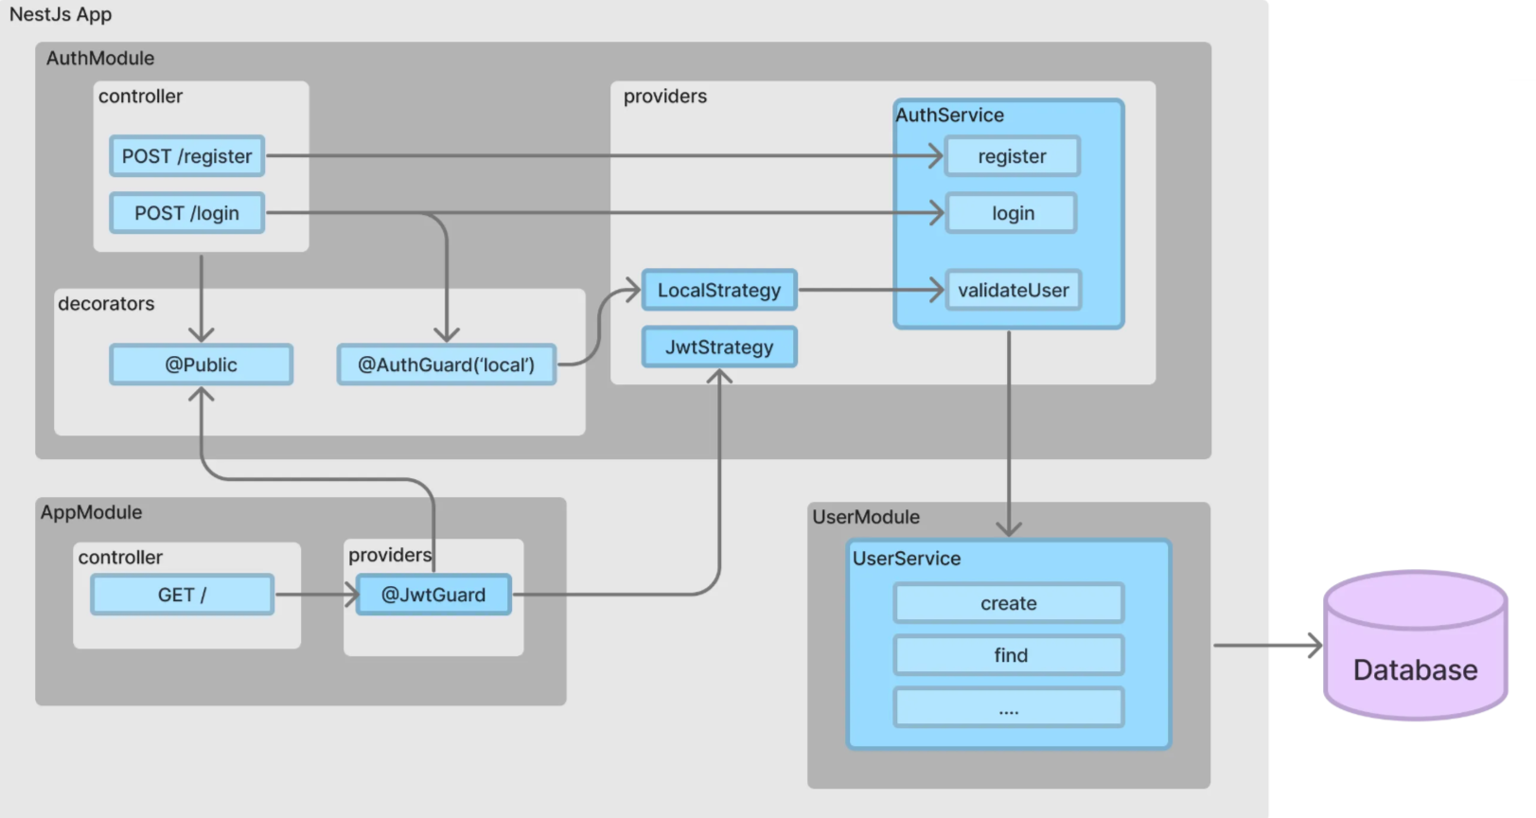
Passport JWT Local Guard with Local Strategy

Slide 100
Questions

